Slide 1
APO Productivity Database Project
Presented by Eunice Lau
(with Koji Nomura and Hideyuki Mizobuchi)
Keio University, Tokyo, Japan
The 2008 World Congress on National Accounts and Economic Performance Measures for Nations

Slide 2
APO Productivity Database Project
Aim: to construct an international database
for growth accounting;
of harmonaised data and methods as much as possible;
covering APO member countries;
China, US and EU15 as reference economies;
Considering to include Australia.

Slide 3
APO Productivity Database Project
Not about pushing the frontier of the methodology
But about extending the scope to cover a new country group
Mindful of practices of other established international databases
Important for the possibility of future joined-up analysis

Slide 4
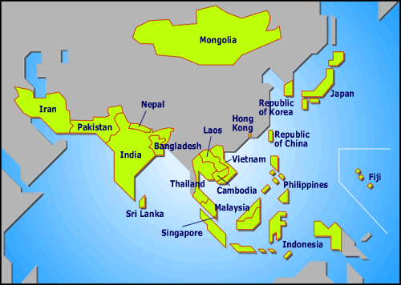
Asian Productivity Organisation
Aim: to drive greater economic development via productivity enhancement in the Asia-Pacific Region
Notes:
The organisation which commissions the project is the Asian Productivity Organisation: APO
Founded in 1961
A regional intergovernmental organisation
Aim: to drive greater economic development via productivity enhancement in the Asia-Pacific Region
20 member countries are: Bangladesh, Cambodia, Republic of China, Fiji, Hong Kong, India, Indonesia, Islamic Republic of Iran, Japan, Republic of Korea, Lao PDR, Malaysia, Mongolia, Nepal, Pakistan, the Philippines, Singapore, Sri Lanka, Thailand and Vietnam.
The conspicuous omission from the group is of course PR China.
Its secretariat is based in Tokyo

Slide 5
APO research
To identify common challenges
→ action plans
Research and surveys
data and analysis
APO data compilation effort started in 2001
Labour Productivity Databook Project
Publication: Asia-Pacific Productivity Data and Analysis
Focus: recent performance and individual country reports
Notes:
To identify common needs in the drive towards productivity so as to develop appropriate action plans that support its member countries’ efforts in economic development via productivity enhancement.
To support its role, APO conducts its own research and surveys, collecting data and formulating their own analysis.
Focus on individual country analysis without a common framework.

Slide 6
APO Productivity Database Project
Launched in September 2007
First task:
to complete APO Productivity Databook 2008
APO Productivity Databook 2008 (March)
Mark an important transition:
Data collected under the old infrastructure of LPDB
But a new analytical framework attempted
A common framework
Long time series (1975-2005)
PR of China, EU15 and the US as reference
The regional and global contexts
Notes:
APO Productivity Databook is the successor to the Asia-Pacific Productivity Data and Analysis.
That is, only for labour productivity calculations, not for TFP calculations.
Data cover APO member countries. The inclusion of the PR China brings the coverage of countries in the report to around 90 percent of the Asian population (according to the UN estimates), making it a more representative study of the Asian regional economy.
These features allow country analysis to be placed in the regional and global contexts and country performance to be compared with each other and over time.

Slide 7
APO Productivity Databook 2008
Caveats:
Data as supplied by the national experts
Internal consistency of country’s dataset checked
But no other adjustments made
Cross-country data comparability not thoroughly investigated
Managed to establish
a common analytical framework
Some uncertainty around the actual results

Slide 8
Level comparisons (PPP-adjusted)
2005, US=100
 | GDP | Per capita GDP | Labour productivity | Labour utilisation
APO countries | 107.9 | 14.4 | 17.4 | 81.6
APO + PR China | 180.1 | 15.2 | 15.7 | 95.9
E15 | 95.4 | 72.8 | -- | --
Notes:
Column one shows the size of this country group relative to the US in 2005. APO countries together (excluding China) is already bigger the US. If China is included, Asia as a group is bigger than the US by 80 per cent.
However the region’s per capita income level is still very low, reaching only around 15 per cent that of the US in 2005, reflecting that Asia is the most populous region in the world.
Per capita income level is determined by labour productivity and the labour utilisation rate. The level comparisons show that there is a lot of room for the Asian countries to catch up with the US while less so in the labour utilisation rate. In fact six out of 20 countries are already having labour utilisation rate higher than the US.
These averages however conceal the vast diversity of this country group. In our report, countries are split into four income groups for further analysis and comparisons.
We observe some evidence that labour productivity explains more the diversity in the progress of the countries in closing the income gap.
We observe that the Asian countries that caught up fast with the US in per capita income were also rapidly closing the labour productivity gap with the US, and had both the highest and a rising labour utilisation rate over the same period.
For countries where there was no catch or saw a decline in relative per capita income, it was their productivity performance that distinguished them.

Slide 9
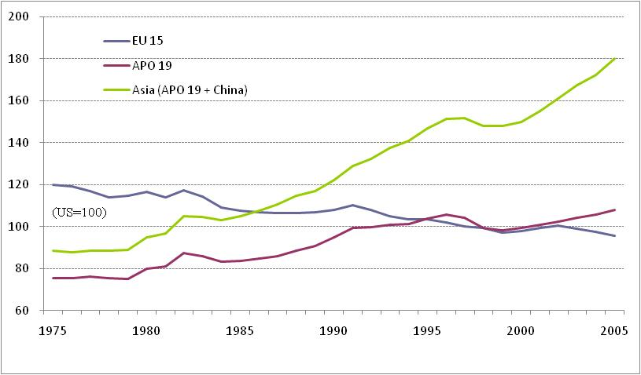
The catch up process
GDP-PPP
Notes:
Comparing the blue and red lines shows the divergence of fortunes of the two regions. While EU declines in its relative size, APO member countries as a group has been catching up with the US.
The difference between the green and red lines is accounted for by the inclusion of China, and clearly depicts the effect of economic acceleration in China.

Slide 10
Regional catch up-country origins
2000-2005
Notes:
In this chart we can see clearly that China accounts for 69.3 per cent of the recent expansion of the relative size of the region’s economy. This is followed by India which accounts for 20.2 per cent.
Japan is the only country which grew more slowly than the US during this period, as reflected in its negative contribution to regional relative growth.

Slide 11
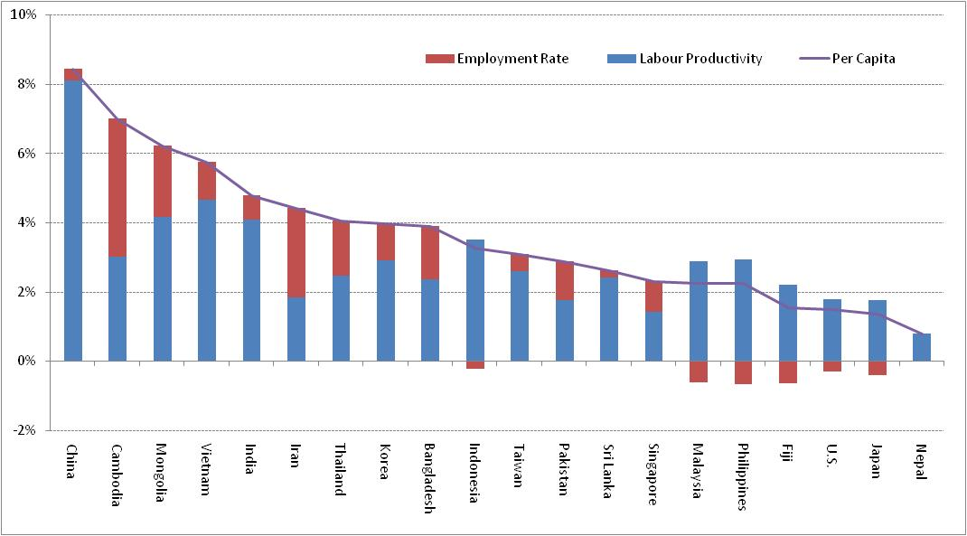
Per capita income growth
Average per annum, 2000-2005
Notes:
Per capita income growth = labour productivity growth + change in employment rate
China’s employment rate is the highest of all countries covered in this report. It was 59 per cent compared with 49 per cent in the US.
Although labour productivity growth also explained the majority of the per capita income growth in most Asian countries, the role played by employment rate should not be underestimated. In countries with positive labour productivity growth and a rising employment rate, the latter accounted for 30 percent of per capita income growth on average.

Slide 12
Industry origins of labour productivity growth
Average growth per annum, 2000-2005
Notes:
Most Asian countries sustained faster labour productivity growth than the US in the recent periods and allow them to catch up with the US.
China’s labour productivity growth was four times that of the US on average per annum in the period of 2000-2005.
On average agriculture made the least contribution to labour productivity growth.
Manufacturing has been traditionally the driving force behind productivity growth. This is true in some countries: China, Korea, Thailand, Malaysia and Japan.
But somewhat surprising is the role that the service sector played. It is particularly prominent in India, the Philippines, Bangladesh and Taiwan. On average for the group, the service sector accounts for 46 % of labour productivity growth compared with 36 % by manufacturing in the period of 2000-2005.
Traditionally service sector made little contribution, if not a drag on, to labour productivity growth. Is this picture painted by the data suggesting that the impact of ICT is also felt in the Asian countries just like in the West, despite the very different economic development stages of the two groups of countries? If this is not reflecting data problems, then what is behind this strength of the service sector in Asia is an interesting question to ask.

Slide 13
Composition of service sector labour productivity growth
Average growth per annum, 2000-2005
Notes:
We did attempt to seek some answer to that question with the data available in the database, although we cannot comment on their quality. We chart these data as supplied to us.
The service sector is divided into four subsectors. With the exception of the purple sector: Community, Social and Personal Services, the other three, to various extent, are potentially IT-using industries. With the exception of Iran and Malaysia, the purple sector made the least contribution to the service sector productivity growth. In Sir Lanka, Vietnam and Taiwan, it even made a negative contribution.

Slide 14
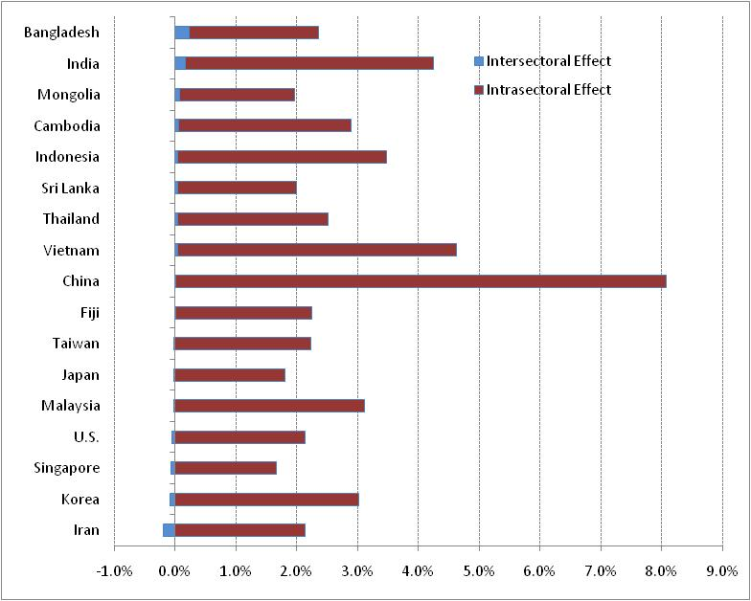
Intra- and inter-sectoral effects
2000-2005
Notes:
An improvement in aggregate labour productivity is a combination of two effects. It could reflect productivity gains within the industry sectors (the intra-sectoral effect) and /or the extent of resource allocation taking place in the economy from low-productive industries to high productive industries (the inter-sectoral effect).
In this chart, average labour productivity growth per annum during the period of 2000-2005 is decomposed into its intra- and inter-sectoral effects.
As expected, aggregate labour productivity growth is predominantly explained by the improved performance wihin each industry sector (the intra-sectoral effect). Even so, the inter-sectoral effect can contribute up to 10 percent to labour productivity growth in Bangladesh or can drag labour productivity growth by up to 9.9 percent in Iran.

Slide 15
Future steps: Databook 2009
Work has already started!
Questionnaire
data comparability issues
adjustments where deemed necessary
Quality of analysis will improve with
a better understanding of the dataset; and
improved cross-country data comparability

Slide 16
Refinements / additions to the current analytical framework
Total actual hours worked
Economic growth analysis
In addition to industry origins,
Contributions by final demand categories
On the supply side, to account labour productivity growth by capital accumulation and TFP growth
(construct capital services for countries which can supply the investment data)
Non-agriculture market sector
Notes:
We seek to denominate labour input in total actual hours worked.

