Slide 1
Troubled FISIM
Itsuo Sakuma
Senshu University
JAPAN

Slide 2
FISIM( Financial Intermediation Services Indirectly Measured)
FISIM (imputed bank service charge)
= Property Income Receivable
(Excluding Income on Own Funds)
Includes: interests receivable, dividends, net rent of land
Minus
Interest Payable
Includes: interests payable to depositors

Slide 3
FISIM (imputed bank services) in 68SNA
In 68SNA, FISIM (imputed bank services) was treated as intermediate consumption of the nominal industry, which has no output itself. Therefore, the size of the activities of financial intermediaries does not directly affect the size of GDP of the country .

Slide 4
FISIM in 93SNA
The allocation of FISIM to final items (final consumption expenditure and export) as well as intermediate consumption was recommended preferably using the reference rate of interest.
However, due to conceptual as well as practical problems, this recommendation was rarely implemented.

Slide 5
The referent rate of interest and the idea of the allocation of FISIM
The referent rate of interest “represents the pure cost of borrowing funds - that is, a rate from which the risk premium has been eliminated to the greatest extent possible and which does not include any intermediation services.” (93SNA, para.6.128)
The reference rate may be the inter-bank rate or the central bank lending rate.
Interest rate on loans, etc.
a
Services to borrowers
Reference rate
r
Services to depositors
Interest rate on deposits
・
d

Slide 6
Allocation using reference rate in 93SNA and its problem
Global FISIM (imputed service charge in 68SNA)
FISIM=aA – dD (1)
Notation: loans A; deposits D; interest rate on deposits d; interest rate on investments a; For simplicity, let us assume D is the only funding vehicle and A is the only type of invested asset.
It was claimed that allocating FISIM by using reference rate r was possible. Thus, according to the assertion,
aA – dD= (a – r) x A + (r – d) x D.
But, in order for it to be in the case, the following equation must be true;
A = D.

Slide 7
New EU regulation about the allocation of FISIM (Eurostat proposal for the minor revision of 93SNA by 2008)
1) Not aA – dD,
but (a – r) x A + (r –d) x D
should be deemed as FISIM.
2) Only loans on the lending side and deposits on the funding side should be taken into account.
3) Central banks should be treated as government-like units whose output is estimated by adding up costs.

Slide 8
There is no such thing as unique reference rate.
It is just impossible to assume such a rate exists in loans and deposits and in domestic and international transactions throughout.
In particular, statistical offices almost gave up the use of the unique reference rate in calculating the export/import of FISIM.

Slide 9
Problems about the unique reference rate
a
a
FISIM=a-r?
a
d
4
a
FISIM cannot be calculated
1
2
3
d
5
r
d
d
a
d
r: reference rate;
d: interest rate on deposits;
a: interest rate on investment.

Slide 10
Replacement
FISIM implementation means the replacement of actual interest flows with the fictional interest flows as far as the financial intermediaries for which FISIM is estimated are involved as lenders or as borrowers.
This replacement may affect other economic statistics rather widely. Is this sound treatment?

Slide 11
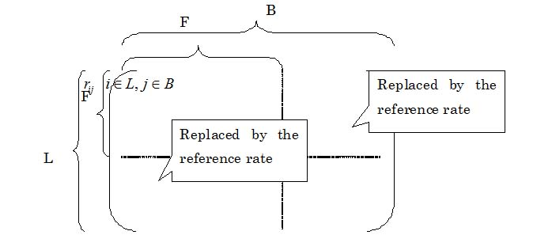
An interest rate matrix
F: A set of financial intermediaries or the number of FIs
L: A set of lenders or the number of lenders
B: A set of borrowers or the number of borrowers
REPLACEMENT
REPLACEMENT
NOT REPLACED
L x B Matrix of interest rates a typical element of which is the interest rate of the i-th lender lending a certain sum of money to the j-th borrower

Slide 12
Are risk premium elements successfully accounted for?
Interest rate (lender i to borrower j )
Since the risk premium should be considered as an (non-life) insurance-premium-type payment, it seems more reasonable to think that most of the risk premium is a contractual transfer, although the existence of the factor of service charges in the premium cannot be denied.
Risk premium
Services
Unique reference rate

Slide 13
Loan/Deposit Rule?
Under the EU regulation, the calculation of FISIM allocation is made by using only loan interests and deposit interests.
The rational for this rule is that only interest rates concerning loans and deposits can be controlled by financial intermediaries.
Interest rates concerning loans (among others) are generally strongly influenced by the relationship between the lenders and the borrowers. Why do you think only service elements are involved.

Slide 14
Central banks, Publicly controlled banks, and Privately controlled banks : Problem of publicness
The distinct border line between what banks do and what government units do can not be delineated.
Even activities of private banks are of some public character. Are such elements properly accounted for in national accounting?
The cost measure may be better.

Slide 15
Allocation of FISIM by industry
It should be questioned whether the proposition that 0.3 unit of FISIM is necessary to produce one ton of steel has any meaning.
FISIM allocation is often impossible for the loan side.

Slide 16
Problem of constant price measurement
The cost about certain model use of bank account may be useful for constructing price index measure for banking services.
Note the cost may explicit or implicit.
The user (opportunity) cost measure may be useful.

